Slide 1
Strategy Games
Sudoku Like Games

Slide 2
Idea Behind the Game
Sudoku is a puzzle involving logic – no arithmetic or guessing is required! The basic idea of completing puzzles is to find cells (the small squares) where you are sure that only one value is a valid placement.

Slide 3
Rules of the Game
Start with the assumption it can have any digit (or value) between 1 and 9, and then remove all values which have already been assigned to other cells in its respective row, column and 3x3 box. This leaves each blank cell with a list of candidates. Repeat the following logical steps until the puzzle is solved.

Slide 4
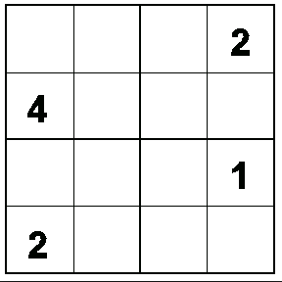

Slide 5
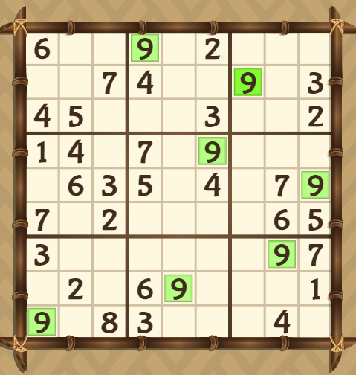
Play 9X9
Online link :http://www.247sudoku.com/sudokuEasy.php

Slide 6
Activity
Step 1
Make group of 2 students and make Sudoku game table of 8 x 8. (total : 64 boxes)
Step 2
First student should start putting numbers (Following the rules of games) and fill half boxes(32 boxes)
Step
Second student will put numbers in remaining half boxes.
How can first person make this game difficult?
Is it possible that the other person will not be able to solve in any situation?

Slide 7
Futoshiki PUZZLE
Futoshiki - also known as "Hutoshiki" or "Unequal"- is a logical math puzzle played on a square grid. The aim of Futoshiki is to place the numbers 1 to 5 into each row and column of the puzzle so that no number is repeated in a row or column. In addition, inequality constraints (< and >) are given between some of the cells, indicating that one cell must be higher or lower than its neighbor.
Below is an example of a 4x4 to show how this is solved.

Slide 8
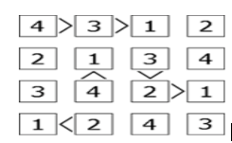
Example

Slide 9
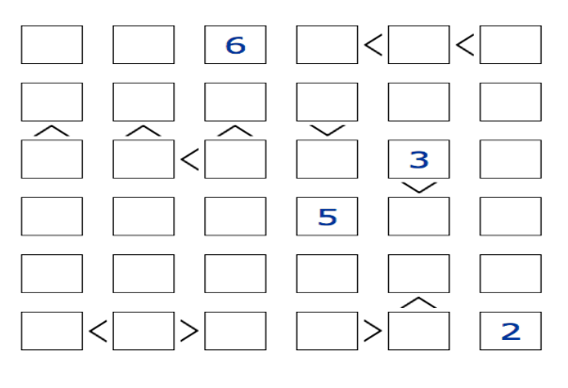
Solve
4
5
5
2
5

Slide 10
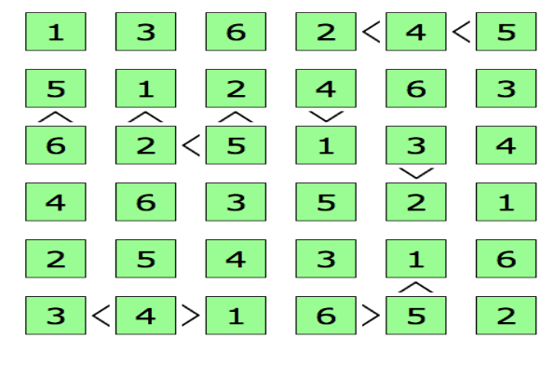
Solution

